Slide 1
Mutation testing
Francisco Zenteno Smith
July 2026

Slide 2
The problem with code coverage
What is code coverage¹:
# lines of production code touched by unit tests
# total production code lines in scope
Test coverage measures code that was touched by unit tests.
It does not check that those tests are able to detect bugs.
In summary: this metric measures quantity, not quality.
Problem:
We could have unit tests with 100% of code coverage
and still be susceptible to bugs.
1) Source: PIT Mutation Testing

Slide 3
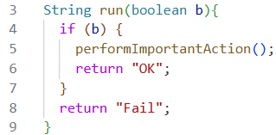
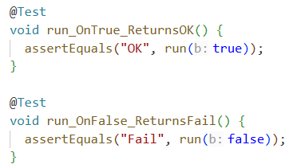
100% coverage testing suite with gaps
The untested side effect
There is no check ever made to make sure the important function is called.
If somebody (an agent?) mistakenly deletes the important function, all the unit tests would still pass and provide 100% coverage
Production
Tests
Lines covered: {4,5,6}
Lines covered: {4,7,8}
Code coverage: 100%
Source: PIT Mutation Testing

Slide 4
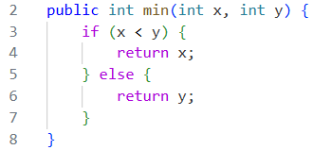
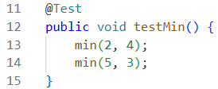
100% coverage testing suite with gaps
The test with no assertions
There are no assertions in the unit test. The function under test is fully executed among all its paths.
If somebody (an agent?) mistakenly changes part of the function, all the unit tests could still pass and provide 100% coverage
Production
Tests
Lines covered: {3, 4}
Lines covered: {5, 6}
Code coverage: 100%
Source: PIT Mutation Testing

Slide 5
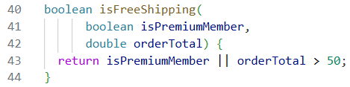
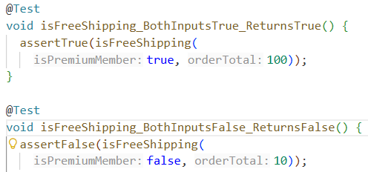
100% coverage testing suite with gaps
Production
The logic blind spot
The tests don’t check all the relevant combinations of inputs.
If somebody (an agent?) mistakenly changes the “||“ by “&&” all the unit tests would still pass and provide 100% coverage
Tests
Lines covered: {43}
Lines covered: {43}
Code coverage: 100%
Source: PIT Mutation Testing

Slide 6

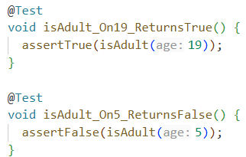
100% coverage testing suite with gaps
The missing boundary test
The behavior at the boundary is not checked (when age == 18).
If somebody (an agent?) mistakenly changes the “>=“ by “>” all the unit tests would still pass and provide 100% coverage
Production
Tests
Lines covered: {25}
Lines covered: {25}
Code coverage: 100%
Source: PIT Mutation Testing

Slide 7
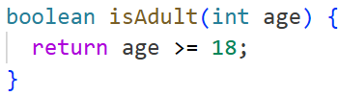
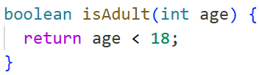
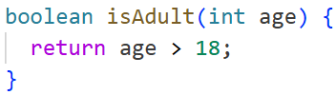
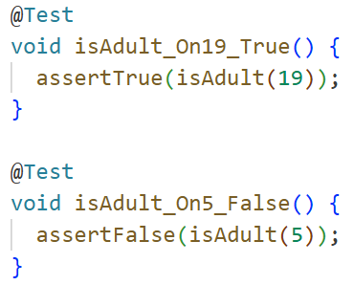

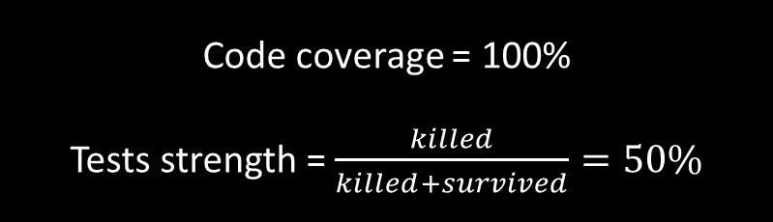

How does mutation testing work?¹
Mutant $1$
…
Mutant $n$
Production
Mutator change-sign²
Mutator change-sign
✓ I am touching all the production lines of code
Code coverage = 100%
Tests strength = $\frac{killed}{killed+survived}=50\%$
Test fails
Test passes
! But there are some bugs I can’t detect
Tests
Test fails
Test passes
Mutant killed
Mutant survived
More info here: Mutation testing – Wikipedia
There are other mutators, refer to the documentation
Notes:
There are many ways of producing mutators, but all share a common thing: they all produce a compiled version of the code that can be unit tested.

Slide 8
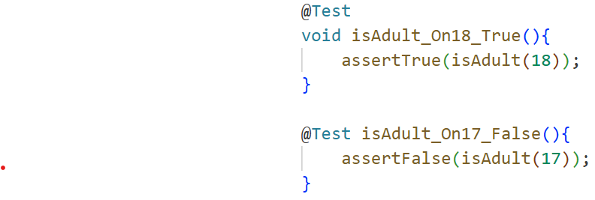
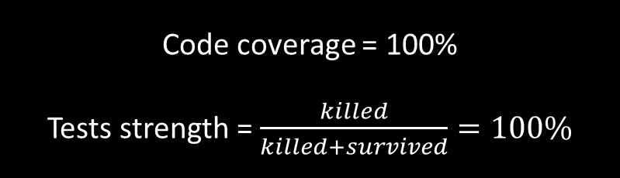
Enhance your unit tests to kill surviving mutants to improve the tests strength
Mutant $1$
…
Mutant $n$
Production
Mutator change-sign²
Mutator change-sign
Code coverage = 100%
Tests strength = $\frac{killed}{killed+survived}=100\%$
My unit testing suite is more robust now
Test fails
Test fails
Tests
Test fails
Test fails
Corrected tests: now the boundary condition is checked
Mutant killed
Mutant killed

Slide 9
Pros and cons
Advantages
Disadvantages
Exposes weak tests (tests that don’t verify behavior fully)
Checks the ability the capture bugs automatically at scale.
Can be automated through libraries, don’t need a human writing the mutation tests.
Provides you with a new perspective when writing code (would this implementation be caught by a mutation test?)
Provides a new safety net against code created by agents.
Slow
You depend on the library used and its support
It may not have full support on some languages (it does in Java and Python at least)
Only meant to be used with unit tests, not integration tests.

Slide 10
How to use it in your continuous integration pipeline
Pick your library according to your language (in Java we have pitest)
Import it into your repository and make sure you can run it on default mode
Create a github workflow that runs mutation testing:
Runs on every PR and when new code is pushed to the main branch (to update baseline)
Alternative: some experts (Uncle Bob) prefer to embed this technique in the agentic workflow within + TDD.
Set up branch code in virtual environment
Define mutation engine (what mutators to generate)
Define scope (suggested: classes that are changing in this PR)
Execute mutation testing and compare to baseline (this will make it faster)
Upload mutation testing report to the cloud so it can be reviewed
Post metrics on the PR and interpretation instructions
Recommendation: don’t enforce a strict PR passing rule (a quality gate) in the beginning, let the team understand this technique first.
Ask your agent for more ideas or modifications to the workflow

